Slide 1
Restaurant Recommender System
Opening a new Indian Restaurant in Chicago City.

Slide 2
ANUJ KUMAR SINGH
26-06-2019

Slide 3
Outline:
Introduction
Data Section
Methodology
Results
Discussion
Conclusion

Slide 4
Introduction
Chicago has been always the busiest place in USA. Being the one of the top financial and industrial cities of the country, city host several offices and working centers. Workers and employees come from the different backgrounds and ethnicity. For Business starters, this is a good situation to start or buy a restaurant in the city. If someone knows where to open a restaurant in the city will be beneficiary information, so that it may generate food profits. Business owners must take many factors into account of selection of the venue.

Slide 5
Introduction(Cont.)
1. Number of restaurants in the neighborhood
2. Crime rate in the place.
3. Type of restaurant.
4. nearest landmarks
5. Accessibility of the restaurant location.
6. Information about other restaurants, hotels, food outlets nearby the location.
With the goal of achieving an informative conclusion to help the business owners to take decision for the selection of restaurant venue, final Capstone will be developed on this problem.

Slide 6
Introduction(cont.)
Target Audience:
People would be interested in predicting whether their business will be profitable. In food service business, along with food quality and services, location of restaurants is also very important. Restaurant chain companies would be interested in this recommender system

Slide 7
Data Section:
My main emphasis is to select the ward which have low crime rate. To achieve this, Crime data of Chicago city is needed. It will be get from
from https://data.cityofchicago.org/Public-Safety/Crimes-2001-to-present/ijzp-q8t2.
For neighborhood restaurants such as number of restaurants, types, geolocation, foursquare apis will be used to extract neighboring Indian and other restaurants, food center etc. Data will we cleaned, segmented and used in the python code.

Slide 8
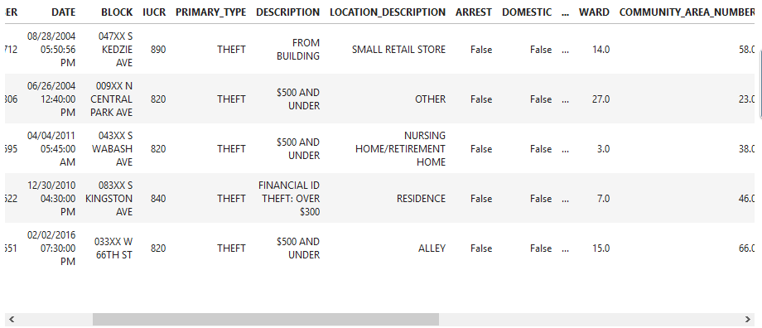
Data Section(cont.)

Slide 9
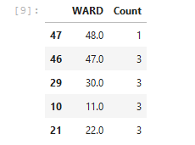
Data Section(cont.)
After performing total count of crime incidents in Chicago, we have found that Ward number 12 has lowest number of crime incidents which is 1.

Slide 10
Methodology
Our main aim is to choose a venue that is less prone to crimes. As bigger crime incidents affect the negative popularity and created problems in running the business. So Less crime affected area means ward that have lowest number of crime incidents will be selected.
A minimal value approach is performed on the crime data collected. Ward number with lowest number of crime incidents is achieved.
We will calculate the location centers of this ward.
Using the foursquare apis, we have explored the nearby venues in which venue category is selected to be food category:

Slide 11
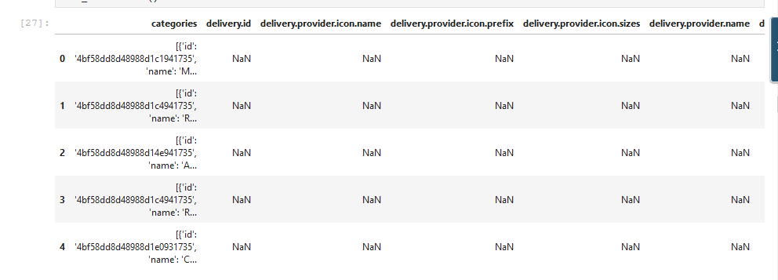
Methodology(cont.)
Explored venues are like containing category, id, location, address.

Slide 12
Results
Total restaurants found nearby in the range of 1000 meter around center location of ward number 12 are 20. But no Indian restaurants were found in this location. So we can open a new Indian restaurant in this area. If any Indian restaurant would have found in this area. So we should have compared its category so that does it differ than the type of restaurant from which we want to open.

Slide 13
Discussion
We could have also applied some constraints on the venue selector such as Per_Capita_Income of each neighborhood in a city. Hardship_Index means which neighborhood’s local residents are getting enough jobs are which aren’t. These factors also help to identify locations which can increase the revenue of restaurant business.

Slide 14
Conclusion
Data science is useful in various ways to achieve data visualizations using different exploratory data analysis. Opening a new Business center or starting a office, First data is gathered and analyzed to predict and explore further possibilities of future problems and difficulties.

Slide 15
Thank You

